Slide 1

Demographic Correlations in Consumer Behavior Case Study: Yelp API Data Ken, Sarah, Alan, Monali

Slide 2
Overview
Yelp API & Census Data
Data Analysis & Trends
Ethnicity
Age
Income

Slide 3
Purpose
Why Yelp?
Nationwide
Available API
Robust
Mainstream
Consumer Behavior

Slide 4
Main Question
Main Question: How does median household income per capita affect the count of Yelp reviews and the subsequent ratings Do restaurants in zip codes where the per capita income is higher have higher rankings as well?
How do population demographics affect Yelp review count and ratings?
Is there a difference in review patterns by race?
By age?

Slide 5
Methods
Which data?
Yelp Data API
Census Data API
Data Analysis (Available Metrics)
Pandas for Data Processing
Seaborn and Matplotlib for Data Visualization

Slide 6
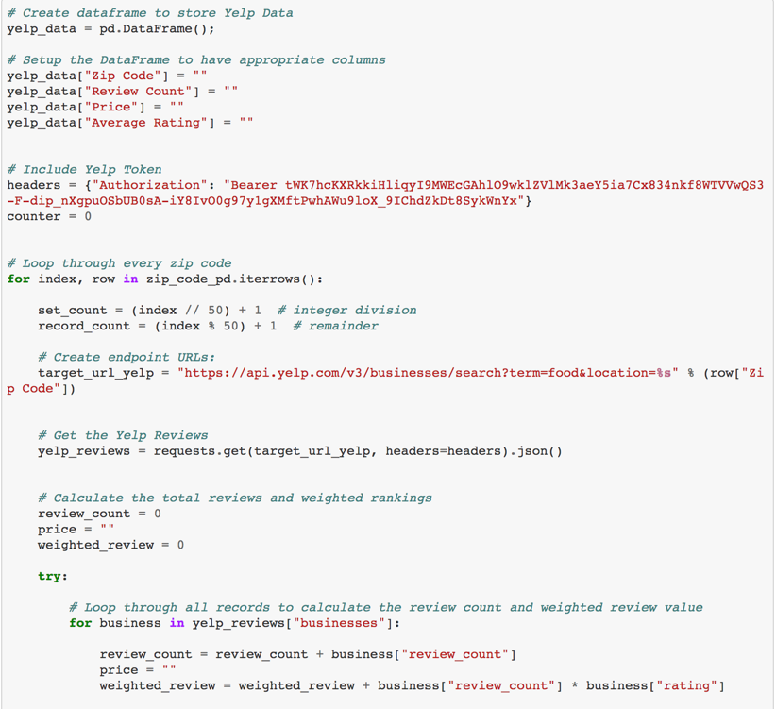
Code: Main For Loop for Yelp Requests
Notes:
Main for loop:
creating the data frame to store the results
create the headers
For loop that ran through every zip code in the CA zip code list to pull Yelp API data for each zip code
Calculate the weighted average review and review count

Slide 7
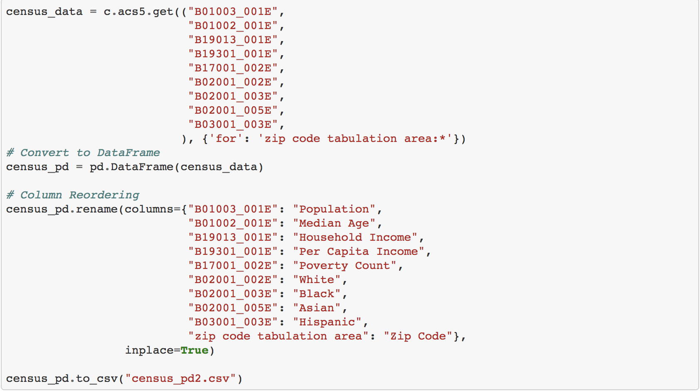
Code: Census Data Requests
Notes:
Main for loop:
The get requests: used the Census column library to find the label we should use for our get request
Convert to a dataframe

Slide 8
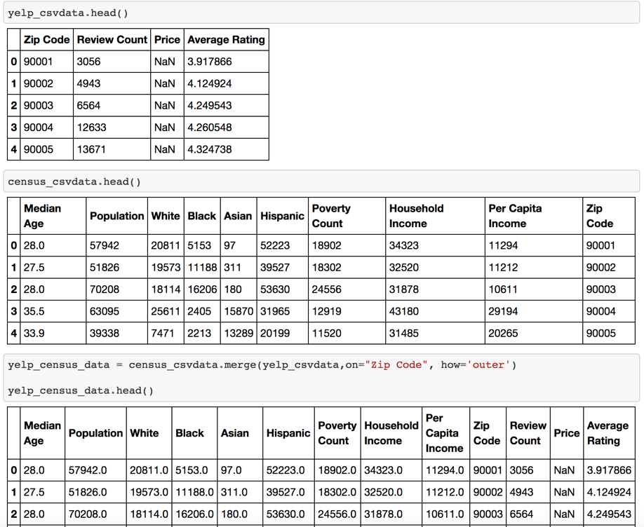
Code: Merging the DataFrames
Notes:
Merged on zip code

Slide 9
Code Challenges
What went wrong?
Large data set so API requests took longer to run
Were not able to pull price from Yelp API output
Too many data points; there were too many zip codes and the data was not conclusive so we restricted it to the top 200 zip codes by population

Slide 10
Metrics
Yelp Metrics
Review Ratings
Review Quantity
Demographics
Age
Ethnicity
Income
Population

Slide 11
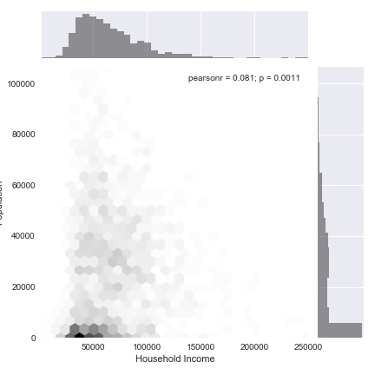
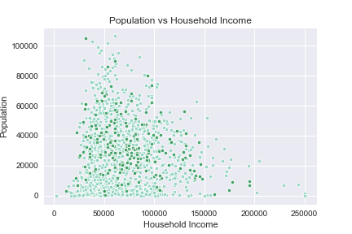
Population

Slide 12
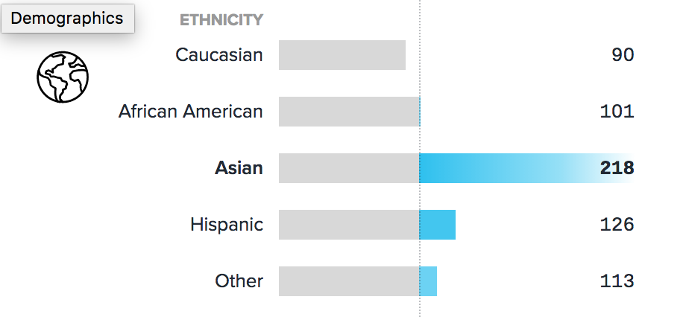
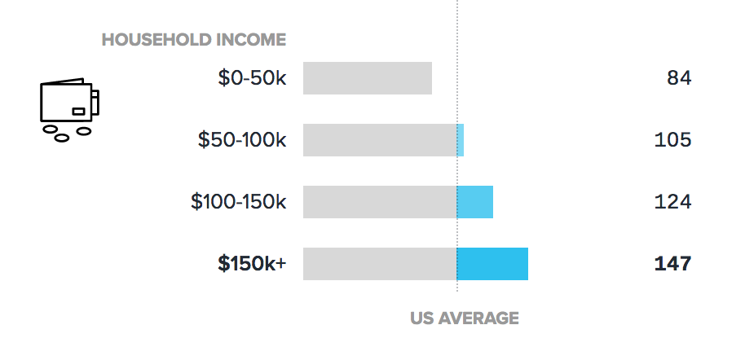
Ethnicity of Yelp Users

Slide 13
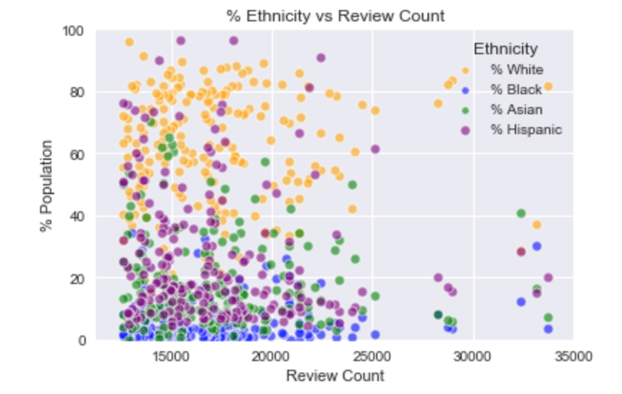
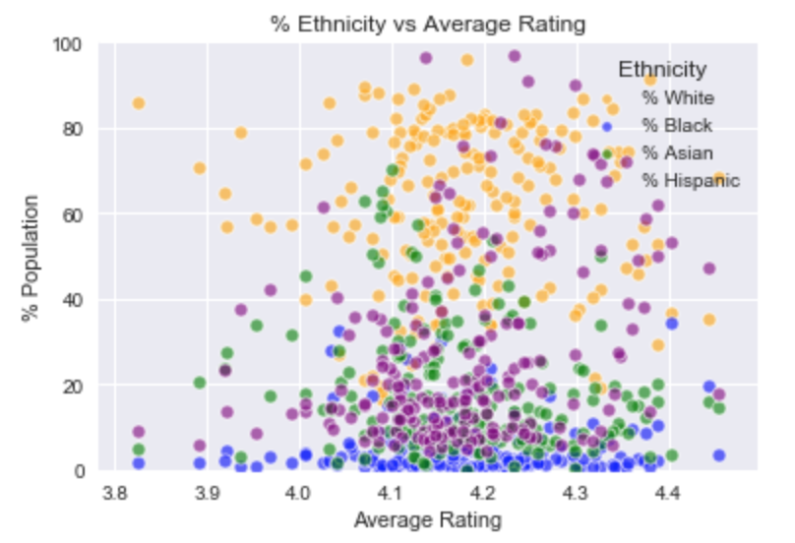
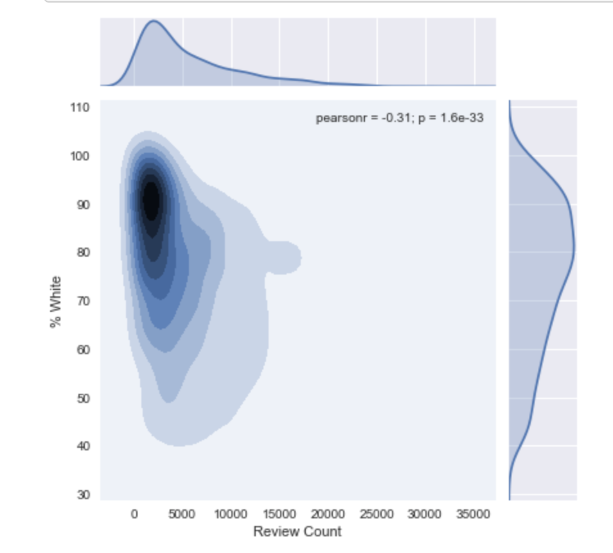
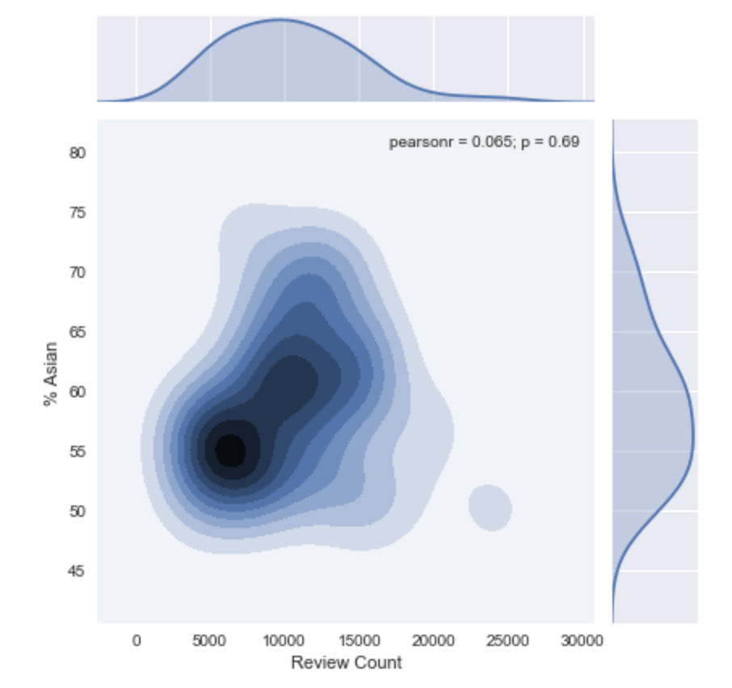
Ethnicity vs. Review Count

Slide 14
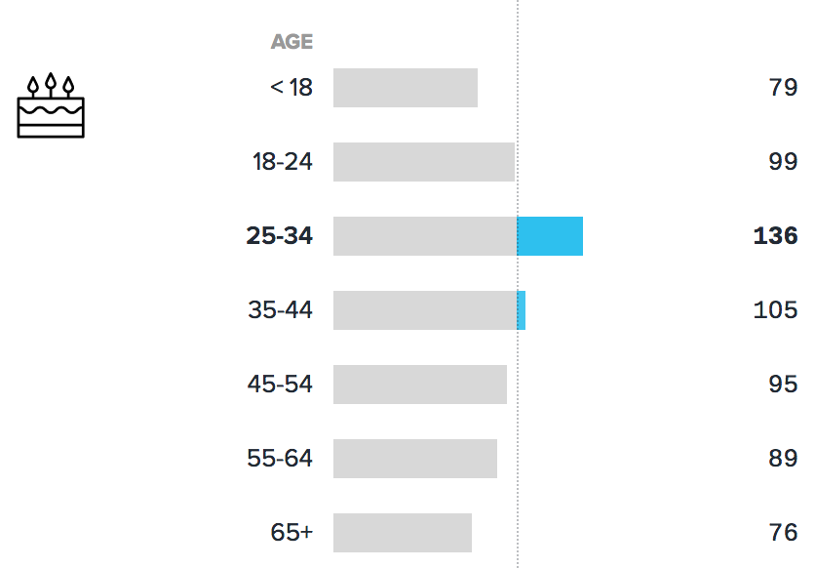
Age of Yelp Users
Notes:
People younger than 30 tend to be harsher with their average rating; <20 avg rating is 4.1; 20-24 avg rating is 4.05
People between 25-35 and 65+ have the highest ratings for restaurants, avg for both age groups is 4.19
Older people write more than younger people; people over 55 have a review count rate higher than 1; review count rate is the number of reviews/population

Slide 15
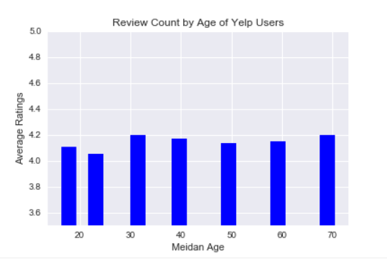
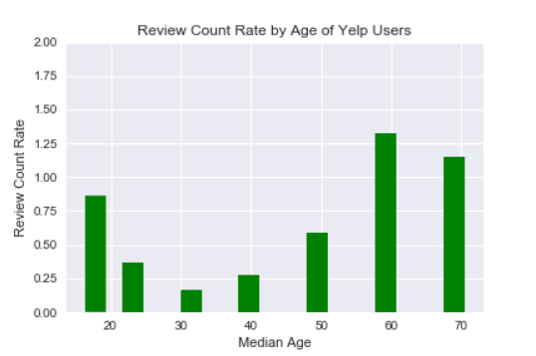
Review Count by Age
Notes:
People younger than 30 tend to be harsher with their average rating; <20 avg rating is 4.1; 20-24 avg rating is 4.05
People between 25-35 and 65+ have the highest ratings for restaurants, avg for both age groups is 4.19
Older people write more than younger people; people over 55 have a review count rate higher than 1; review count rate is the number of reviews/population

Slide 16
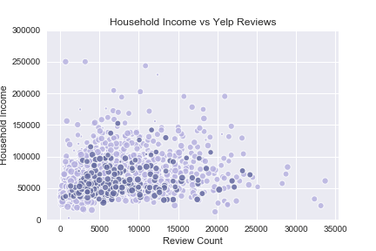
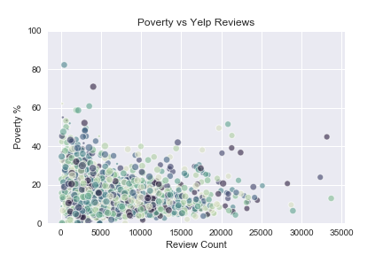
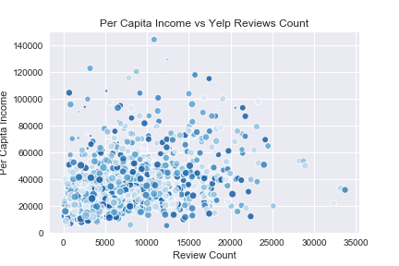
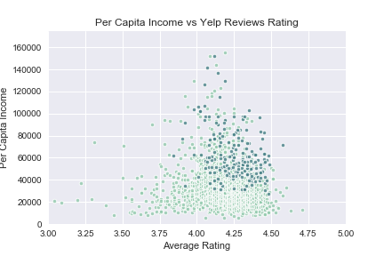
Income

Slide 17
Conclusion
Ratings
Do consumers skew towards ratings that are more favorable or unfavorable?
Users were more likely to provide above average reviews that were favorable.
Demographics:
Do socio-economic factors of an area affect the local business ratings and reviews?
Businesses in affluent zip codes were more likely to receive favorable reviews.
Conclusion
Yelp ratings were more consistent than expected and represent the typical user experience rather than being skewed by extremes.

Slide 18
Limitations
Price
We were unable to segment by price (ie. Burger King vs. Steak House)
Data Set
Yelp data and Census data are not necessarily aligned
Yelp data has a selection bias (user-generated vs. random sample)

Slide 19
Further Research
Genre
Segmenting ethnicity data by genre of cuisine.
Cultures
Looking at other languages or countries.
Device
Comparing the app vs. website version.
Franchise
Comparing data trends for franchise vs. independent.

Slide 20
Thank you

